Slide 1
Fintech Project 2:
Credit Risk Analysis
Using simulated dataset from credit bureau

Slide 2
Executive Summary
The project will leverage machine learning techniques and models to analyze credit data and identify patterns and trends.
Completed by: Ganna Kassantini, Sun Hao, Ahmed Kainat, Sujandar.

Slide 3
The following models were used:
Linear Regression Model
Knn model
Datasource: Kaggle.com
Data cleaning: removed by using dropna missing values from the dataset.

Slide 4
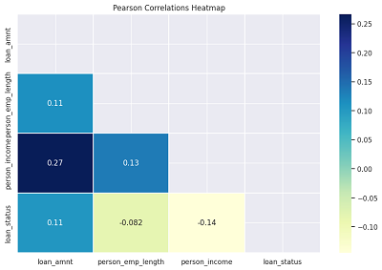
Pearson Heatmap was used to view the correlations:
The amount of credit is dependent on the annual income of the borrower
Linear Regression Model
Knn model

Slide 5
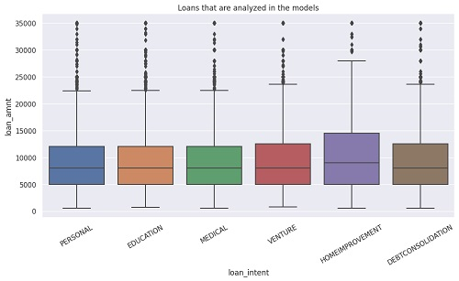
The categories of the loans analyzed in the models: Personal, Education, Medical, Venture, Home Improve, Debt Consolidation
Linear Regression Model

Slide 6
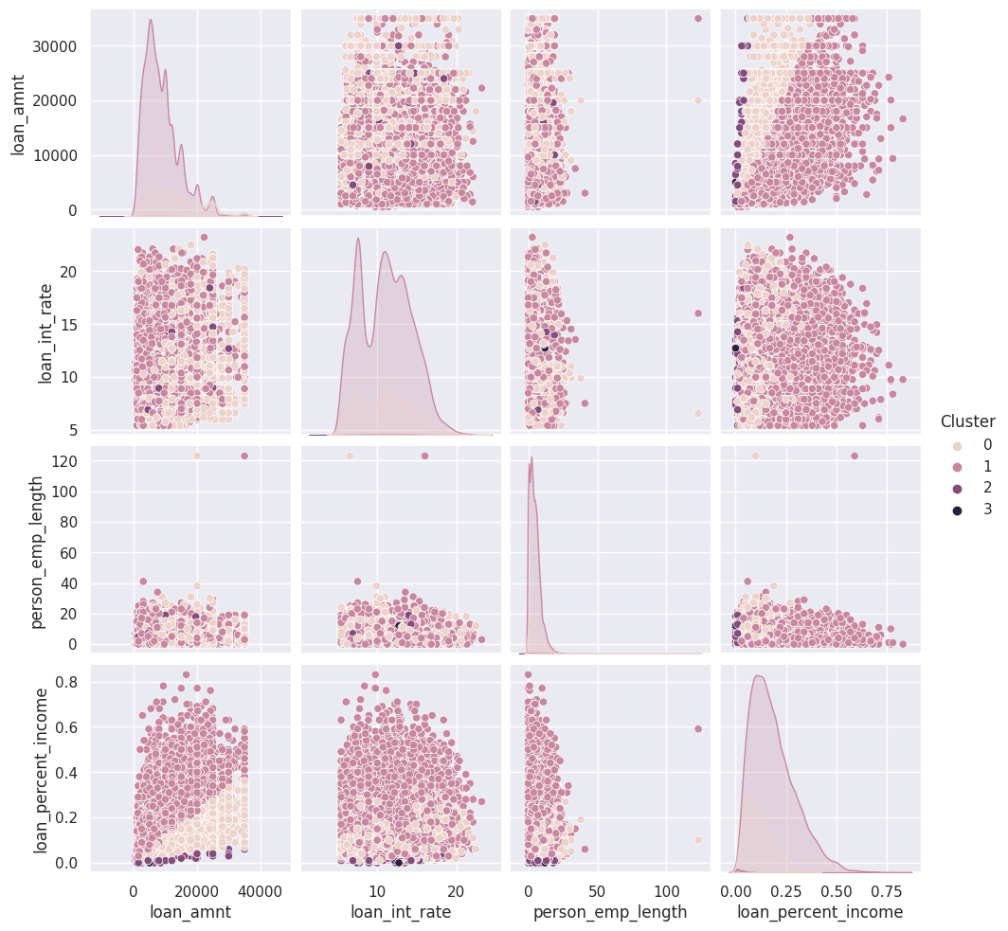
Results of the KNN Clustering
Which factor is more important to result of the clustering?

Slide 7
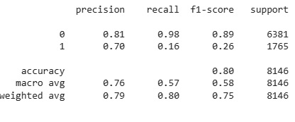
Linear Regression Results
Accuracy is low in this model compare to KNN model, other models can be used to do the prediction such as SVC, Random Forest, etc.

Slide 8
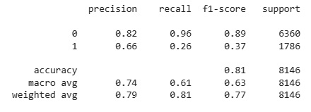
Knn Model Results:

Slide 9
Link to GitHub.com

